Slide 1
OLDBookS Shop
Idea and OUTLINE
Aviral Takkar
Delhi Technological University

Slide 2
Basic Plan
This app is going to serve as a digital platform to enable users to purchase ‘available’ listed books by directly contacting the seller. In addition, the user may himself upload meta-data about books he wishes to sell. The idea is to build this app along the lines of digital classifieds such as OLX, restricted to used books.

Slide 3
Main Components
Catalogue
User Account
Books uploaded for sale by user

Slide 4
The Catalogue
This would be the home page of the app, where the user would be able to view all books available for purchase that have been uploaded by all other users using the app. For this purpose, server space would be required to create and maintain a database of users and the information about the books they have to sell. A search tab would be provided to look for specific books in the catalogue.

Slide 5
User Account
To upload books to the market, a user must first create an account. The user must choose a username and password and provide his contact number and email ID (which would serve as primary key). After confirming the email address, the user’s account would be created. Once the user logs in and returns to the market, the user would not be able to view those books that have been uploaded by him, in the market.

Slide 6
Books Uploaded for sale
To upload books, the following information would be need from the user
A recent photograph of the book to be sold.
The name and author of the book.
Duration for which the book has been owned
Rate condition of book
Other comments

Slide 7
Operation
The user must provide the following additional information about the book
Publisher
Retail Price
The user will then quote a price to the sell the book at.
On completing this process, the book would be linked to the user’s account and uploaded to the server. The uploaded books would appear in the “My Books” tab to the user, and would appear in the global market to others.

Slide 8
Operation
When a user wishes to purchase a book
He may browse the catalogue and select a book he wants to purchase.
He may use the ‘search catalogue’ option to look for the desired book.
Once the book has been selected, the contact information of the seller of that book would be provided to the user. It is an open choice whether to provide this information through email or make it openly available.

Slide 9
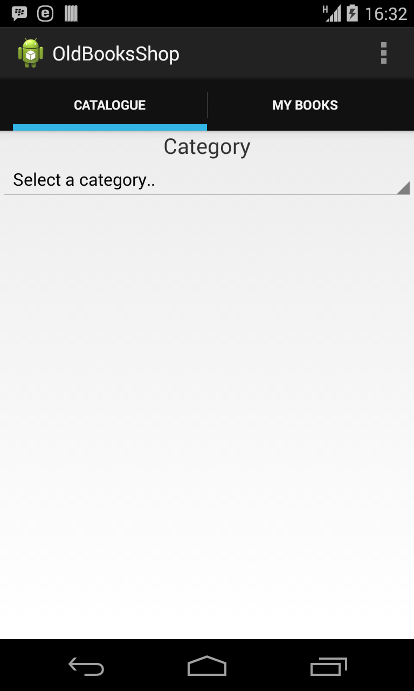
Home Page

Slide 10
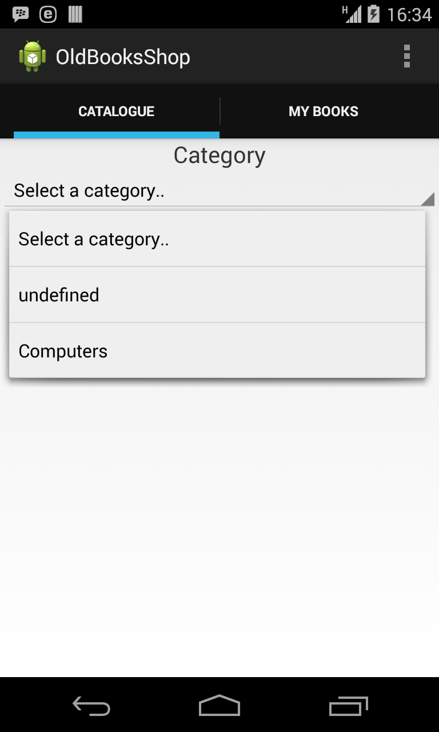
Category Selector

Slide 11
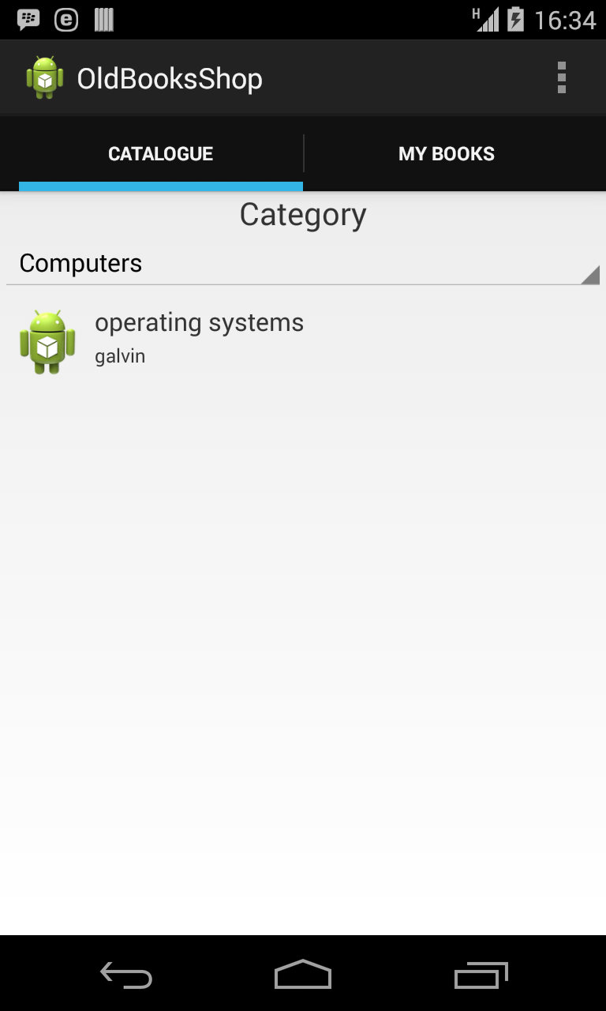
On selecting a category

Slide 12
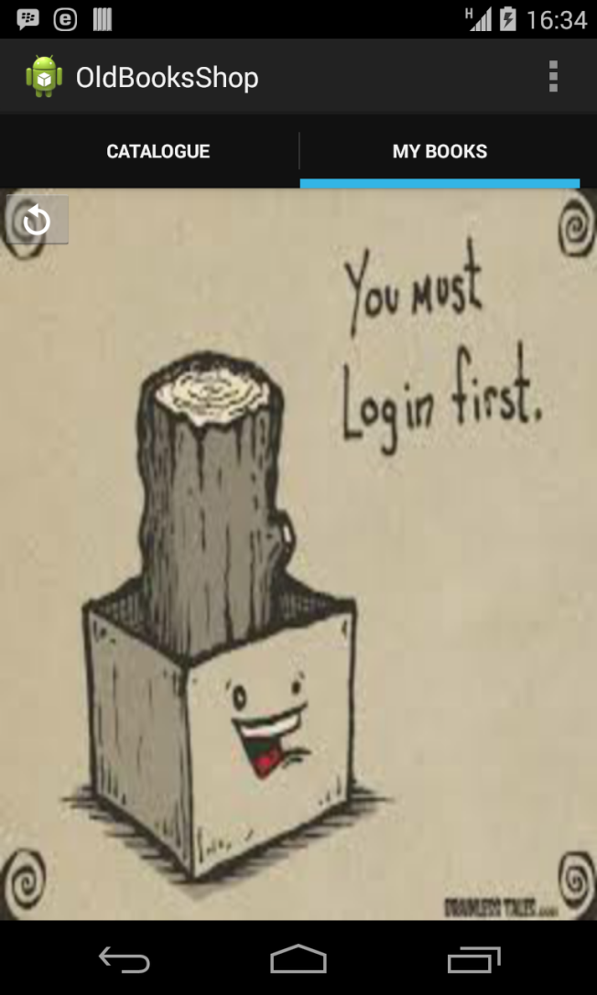
On viewing ‘My Books’ without logging in

Slide 13
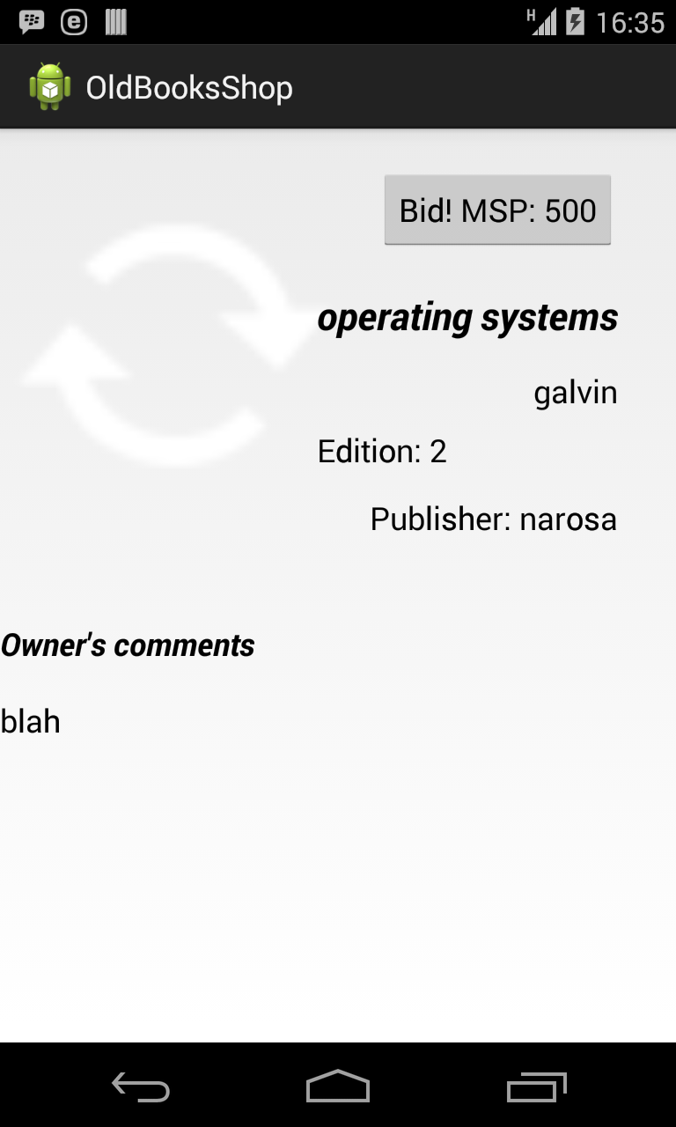
On selecting a book (skeleton design, image excluded)

Slide 14
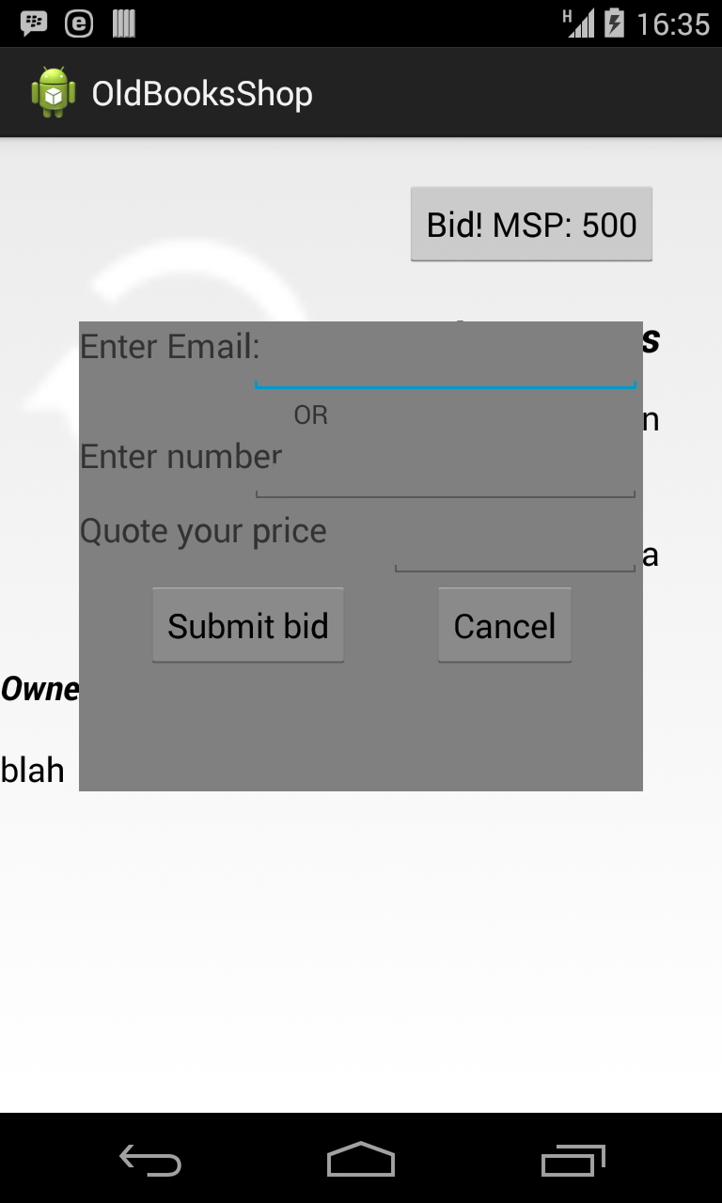
On clicking ‘Bid’ button, popup is shown

Slide 15
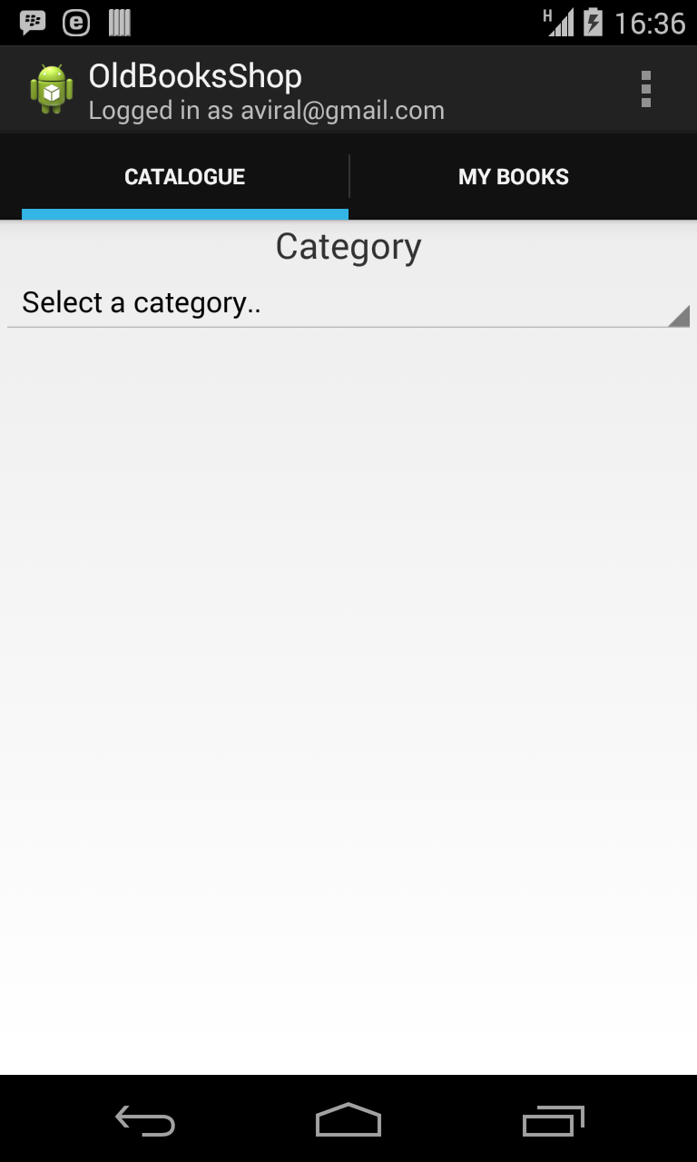
On logging in, action bar subtitle modified

Slide 16
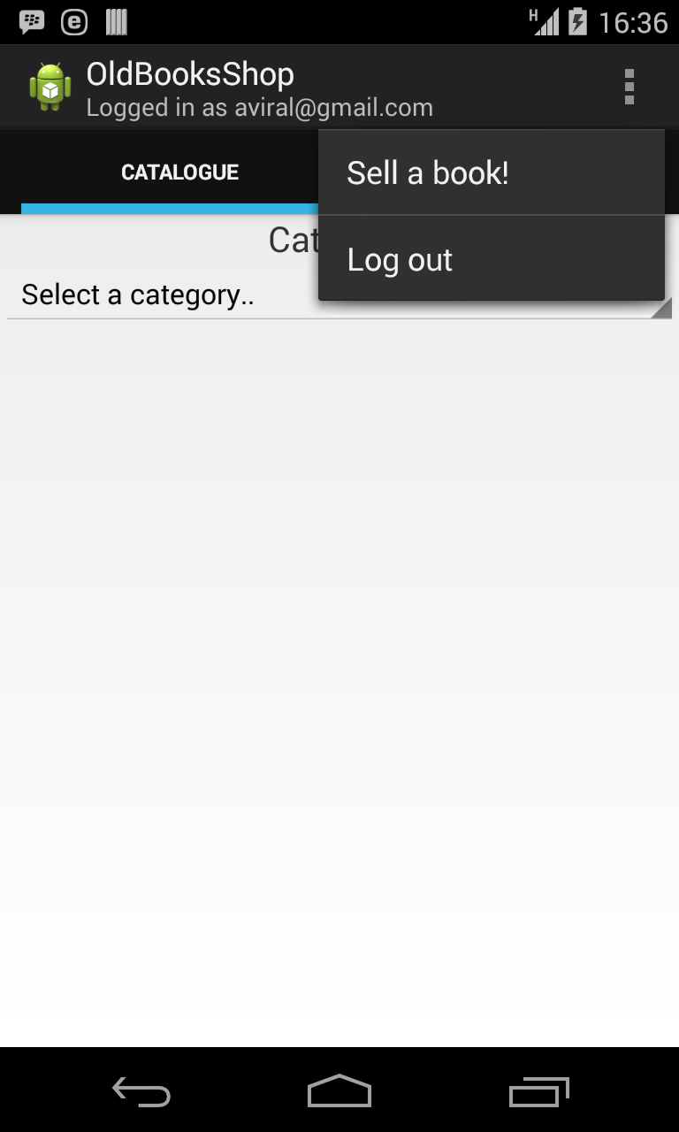
On logging in, context menu entries modified

Slide 17
Additional Aspects
The categories are updated through android system service, and cached in a database in the device. They will be updated in intervals as selected by the user (daily, hourly, weekly, etc)
A user on logging in stays logged in till he logs out by clicking ‘log-out’ in the context menu. Only one user is logged in at a time.
‘Sell book’ and ‘my books’ pages are yet to be implemented.

Slide 18
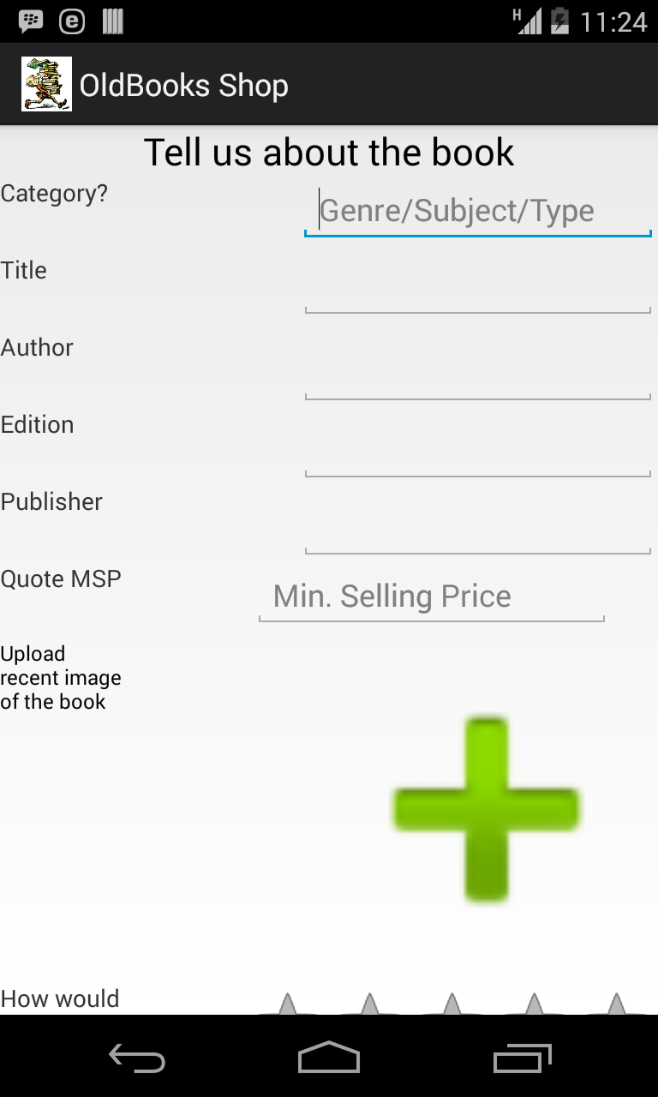
Sell a book

Slide 19
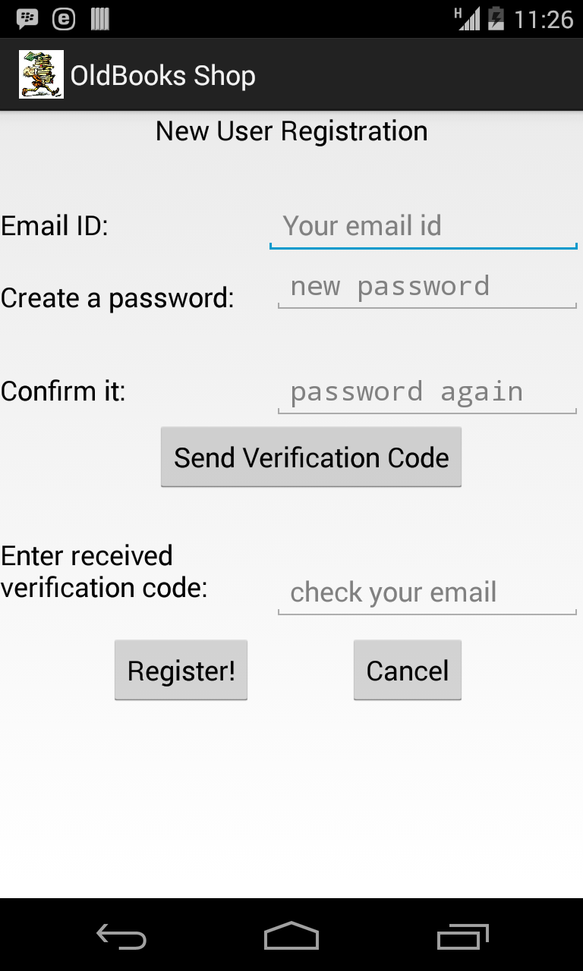
On selecting Sign-up

